Slide 1
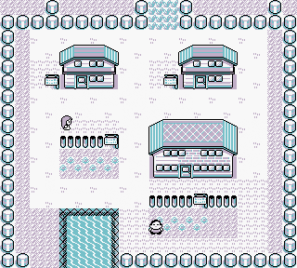
Pokémon : Gotta select * all
Team Rocket Recruits:
Jordan Tiu
Matt Hopkins
Reed Bader

Slide 2



Introduction: THE GAME THAT CHANGED A GENERTATION!
1996, Nintendo released a game about exploring a world while catching interesting creature and become the very best, like no one ever was.
1998 :years later, it was released in America and quickly it has grown to the point that is globally recognized.
We chose to create a database of the first generation of Pokémon due to a couple of reasons. The main one
it was easy to get into for someone who doesn’t know much about it. But also since we had a general passion for the games and thought that we could do something that would make us interested and excited to do and finish.

Slide 3
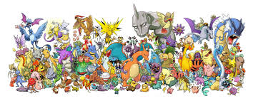
What we started doing
We chose to initially create a pokedex, but when we looked at it, we had the thought of, ‘nah, we can do better’. So we added and created a user profile, a login, the user’s collection of Pokémon as well as a pokedex.

Slide 4
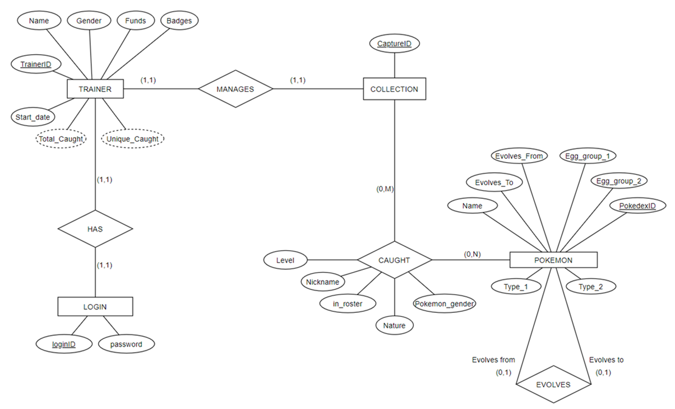

Slide 5
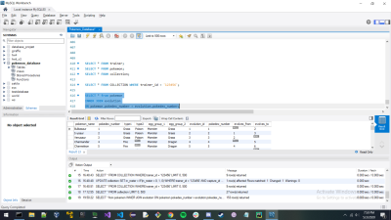
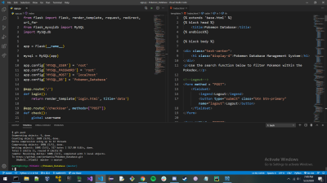
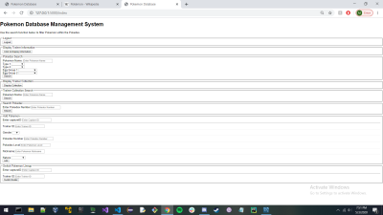
The PC and database of Pokémon
MySQL
Python w/ flask extension & MySQL connector

Slide 6
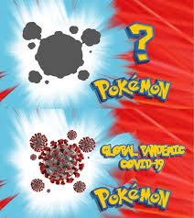
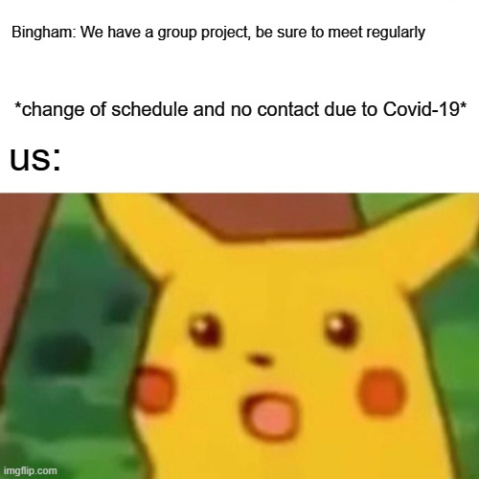
Issues and conclusions
Due to the outbreak of Covid, there was some difficulty meeting due mostly to the fact that schedules changed a little and we could no longer meet in public. But with the use of discord and some talk, we got over that. We didn’t have to change much which was lucky.

